Slide 1
CHAT-BOT SYSTEM FOR COMPUTERS, ACCESSORIES & REPAIR CENTER RECOMMENDATION
TMP – 23 - 283
Notes:
HOW TO START >>> Give real world example when we try search for a device.
(Good Afternoon All, Let me initiate our presentation asking this particular Q….)
How many hours have you spent searching the internet, asking friends when you are willing to buy a new device? In particular a Laptop, PC accessories or even repair centers.
Personally, as IT enthusiastic this is interesting for us, yet sometimes a hassle. And most definitely, it’s a hassle for who aren’t doesn’t have a IT domain knowledge, isn’t?
THUS:
Hybrid of Chat bot & recommender system for devices, accessories & repair centers.

Slide 2
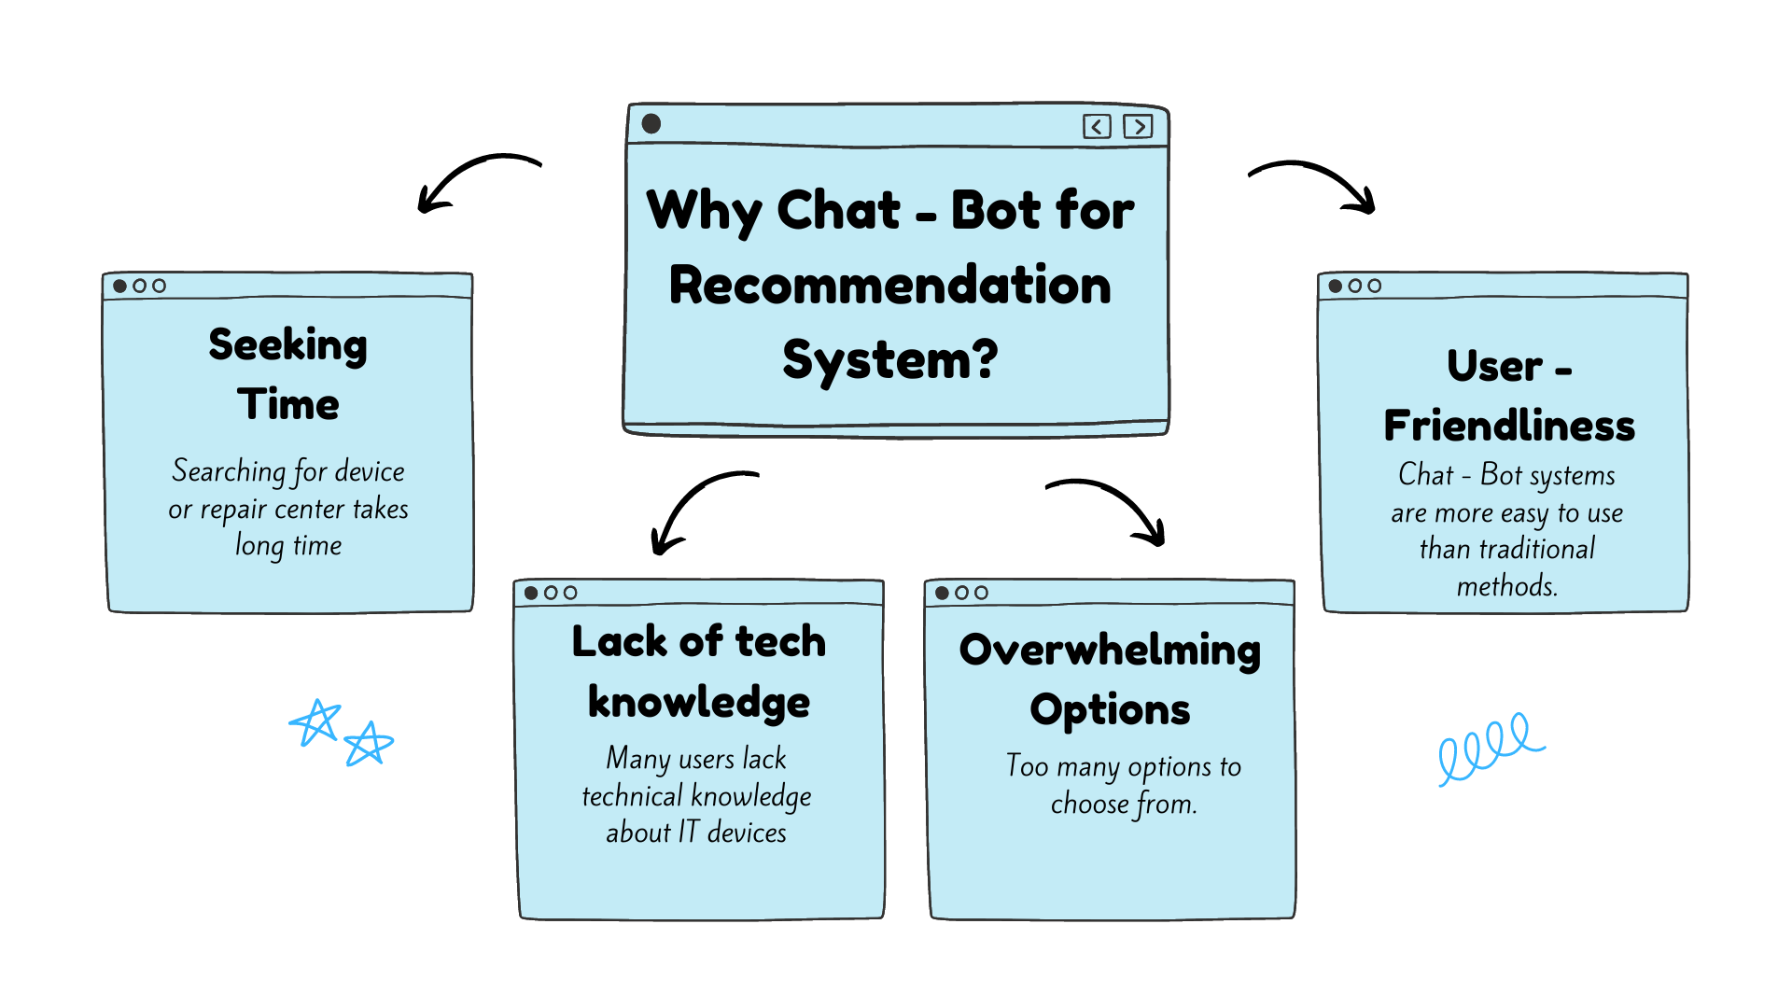
Research Problem
CHAT-BOT SYSTEM FOR COMPUTERS, ACCESSORIES & REPAIR CENTER RECOMMENDATION
Research Problem
Notes:
Identified problems in the real-world scenario: (Reason to implement such system)
Seeking time
Lack of knowledge
Too many options to choose from

Slide 3

Research Objective
Increase user satisfaction and cater their needs
User needs are determined by a Chat-Bot system using query processing and image processing
Image processing to identify computer accessories & Query processing to identify keywords
CHAT-BOT SYSTEM FOR COMPUTERS, ACCESSORIES & REPAIR CENTER RECOMMENDATION
Research Objective
Notes:
Increase User Satisfaction by introducing a Cha-Bot system.
Identify user needs via Chat-Bot system. (Inputs – Both Query & images)
Using Image processing to identify computer accessories & Query processing to identify keywords.

Slide 4

Research Objective
Recommender system to suggest devices & repair centers based on online reviews & product specification
Web scraping and speech to text system from video reviews to gather data
CHAT-BOT SYSTEM FOR COMPUTERS, ACCESSORIES & REPAIR CENTER RECOMMENDATION
Research Objective
Notes:
Implement state of the art recommender system to recommend devices and repair centers.
Last but not least, using web scraping & speech to text systems to gather info. About devices.

Slide 5
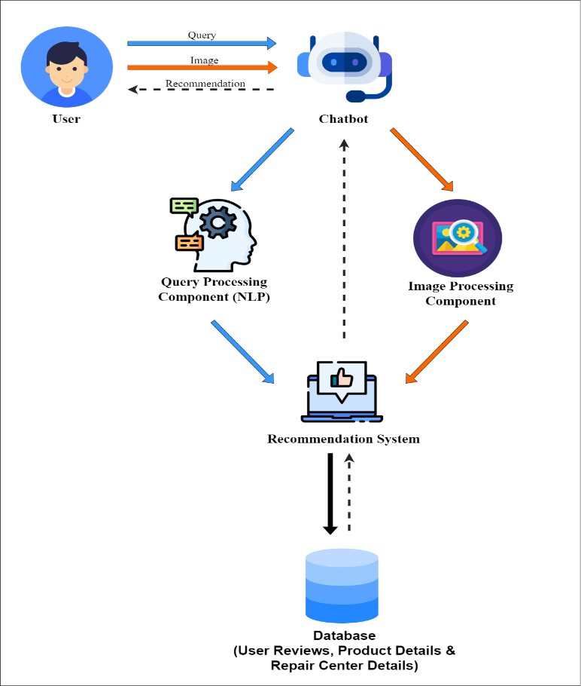
Overall Diagram
CHAT-BOT SYSTEM FOR COMPUTERS, ACCESSORIES & REPAIR CENTER RECOMMENDATION
Overall Diagram
Notes:
High level architecture.
All 4 components of our system are included.
Chat Bot & NLP
Image processing Component
Recommender System
Web Scraping for data gathering & speech to text from video reviews.
My colleagues & I will dive into specifics in the individual components.

Slide 6
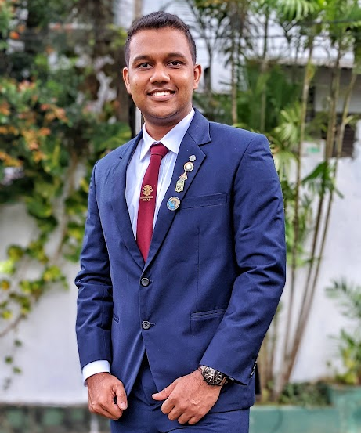
IT20225506 | Thirimanne S.U
B.Sc. (Hons) Degree in Information Technology Specialized in Data Science
IT20225506 | THIRIMANNE S.U | TMP – 23 – 283

Slide 7

Objective
Specific Objective: Objective of this component is to develop a Chat-Bot interface to identify user requirements.
Identify specific keywords from the user query through NLP.
Sub Objectives:
Modify Chat-Bot system to input audio.
Modify Chat-Bot system in order to input images for image recognition system.
IT20225506 | THIRIMANNE S.U| TMP – 23 – 283

Slide 8
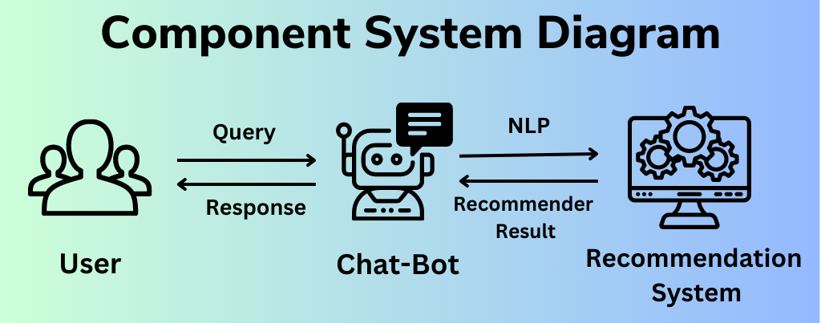
Methodology
IT20225506 | THIRIMANNE S.U | TMP – 23 – 283

Slide 9
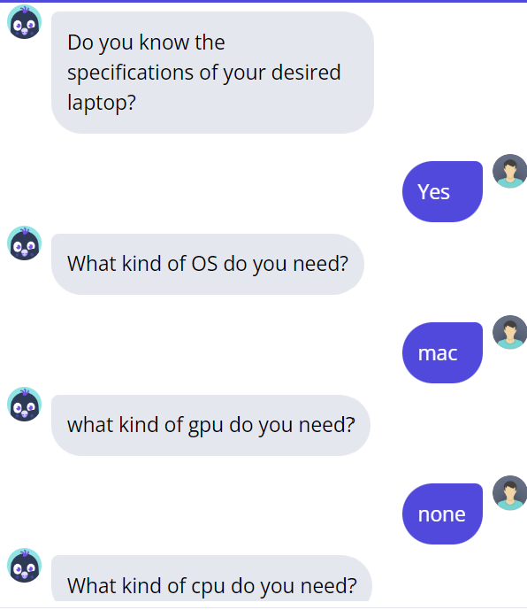
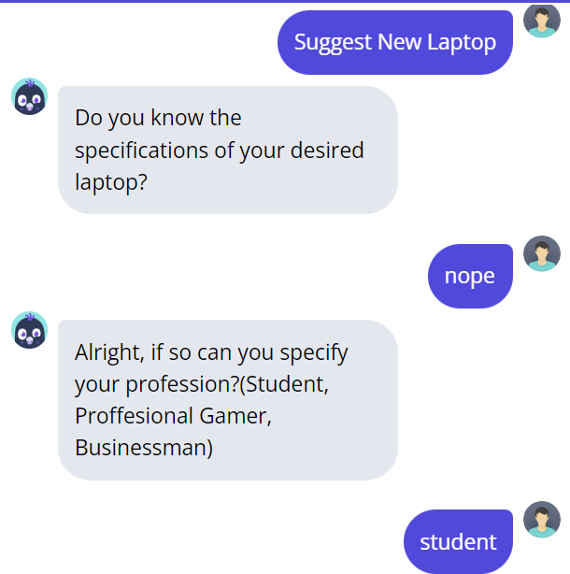
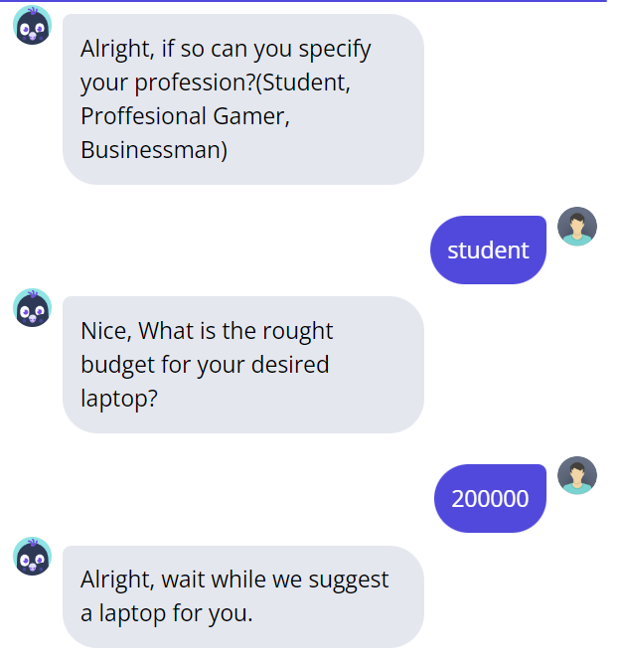

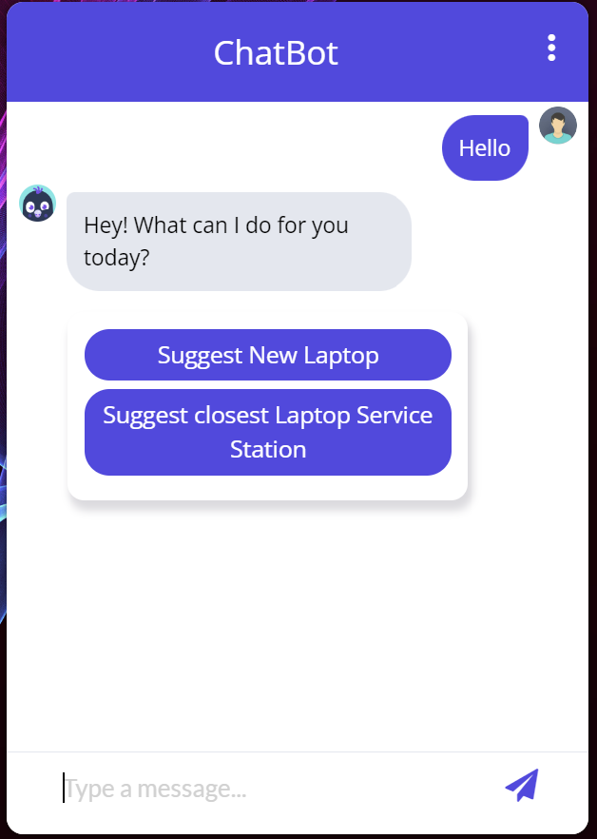
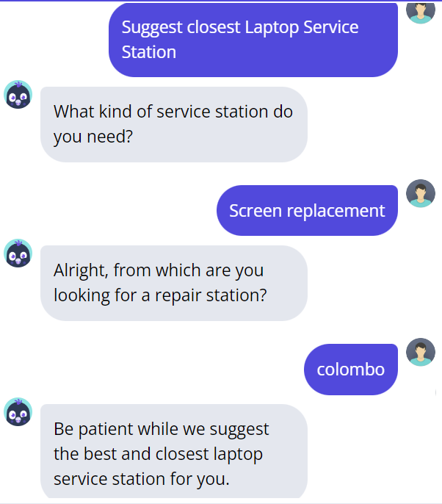
IT20225506 | THIRIMANNE S.U | TMP – 23 – 283

Slide 10
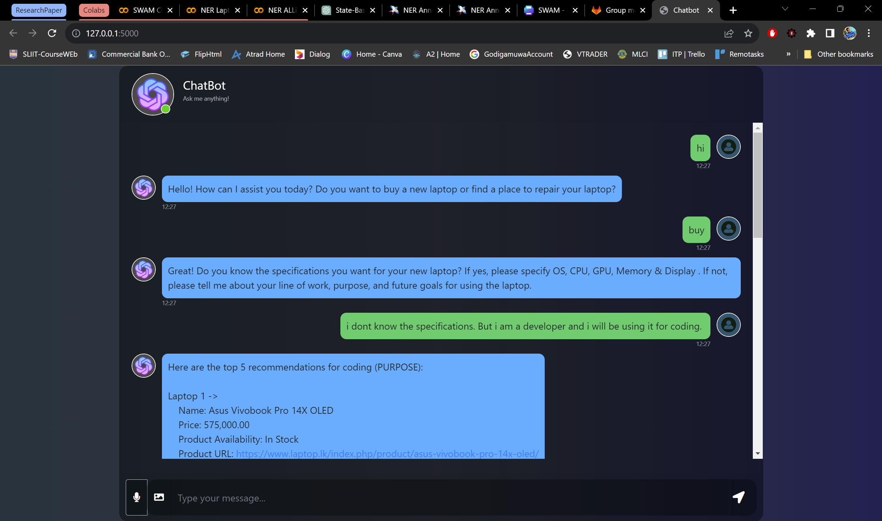
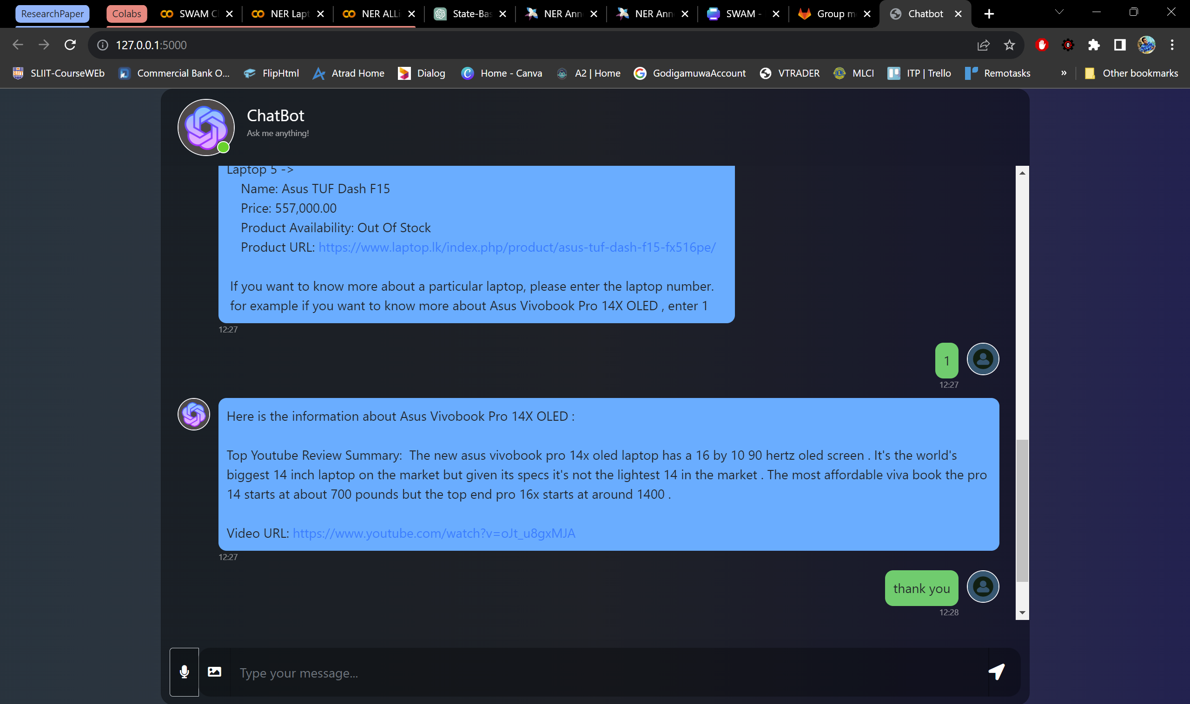
State Based Chat Bot System
Technologies:
Flask, HTML, CSS, JavaScript
To Enhance and reduce latency :
Content Delivery Network (CDN)
IT20225506 | THIRIMANNE S.U | TMP – 23 – 283

Slide 11
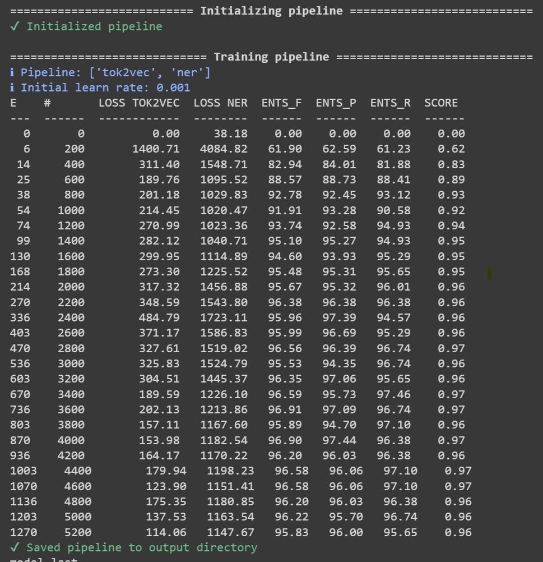
Name Entity Recognition (NER)
text = "I'm am a developer . I want to buy a laptop with RTX 3050, intel i7, 144hz refresh rate with 14-inch screen"
Entity: developer, Label: JOB
Entity: RTX 3050, Label: GRAPHICS
Entity: intel i7, Label: PROCESSOR
Entity: 144hz, Label: REFRESH RATE
Entity: 14-inch screen, Label: DISPLAY
IT20225506 | THIRIMANNE S.U | TMP – 23 – 283

Slide 12
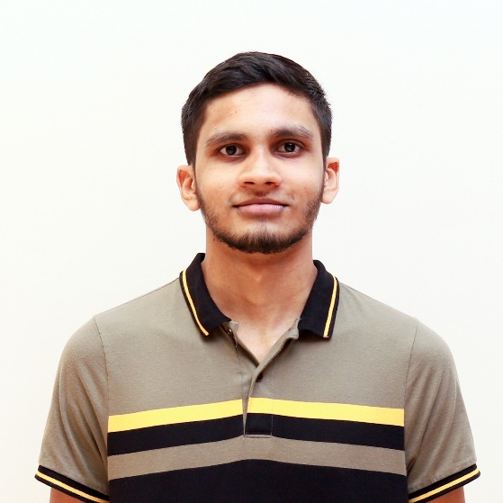
M.U. Amanullath | IT20155520
B.Sc. (Hons) Degree in Information Technology Specialized in Data Science
IT20155520 | M.U. Amanullath | TMP-23-283

Slide 13

Research Question
How to classify image of a computer hardware fast and accurately so that it can be used in a chat bot?
IT20155520 | M.U. Amanullath | TMP-23-283

Slide 14

Research Gap
While the existing work demonstrates how to implement object detection [1][2], it does not specifically address the identification of computer hardware components. There is a need for a specialized approach to accurately and efficiently identify computer hardware components in near real-time.
IT20155520 | M.U. Amanullath | TMP-23-283

Slide 15

Specific Objectives
The objective of this component is to develop a near-real-time computer hardware identification system that can accurately identify computer hardware components (mainly RAM and storage).
Integrate the classification algorithm into a chat bot interface for real-time identification and user interaction.
IT20155520 | M.U. Amanullath | TMP-23-283

Slide 16
Sub Objectives
Collect images of computer hardware components and label them using appropriate labeling tools.
Extract the high-level features of the images using a pre trained model.
Extract the most common keywords from the images using Optical Character Recognition (OCR)
Perform similarity checking when a new image is uploaded with our dataset and perform keyword analysis to extract extra information.
IT20155520 | M.U. Amanullath | TMP-23-283
Notes:
YOLO: YOLO stands for "You Only Look Once." It's an object detection algorithm that can quickly identify objects in an image and label them with a bounding box. It's called "You Only Look Once" because it only needs to analyze an image once to detect objects, unlike other algorithms that may need to analyze an image multiple times. This makes it a very fast and efficient algorithm for object detection.
Faster R-CNN: Faster R-CNN stands for "Faster Region-based Convolutional Neural Network." It's another object detection algorithm that uses a combination of a convolutional neural network (CNN) and region proposal network (RPN) to identify objects in an image. Essentially, it first generates potential regions in an image where objects may be located, and then uses the CNN to identify and label objects within those regions. It's a very accurate algorithm, but can be slower than YOLO.
Faster SqeezeNet: Faster SqeezeNet is similar to Faster R-CNN in that it also uses a CNN to identify objects in an image. However, it's different in that it uses a smaller and more efficient CNN architecture called SqeezeNet. This makes it faster than Faster R-CNN, but potentially less accurate.

Slide 17
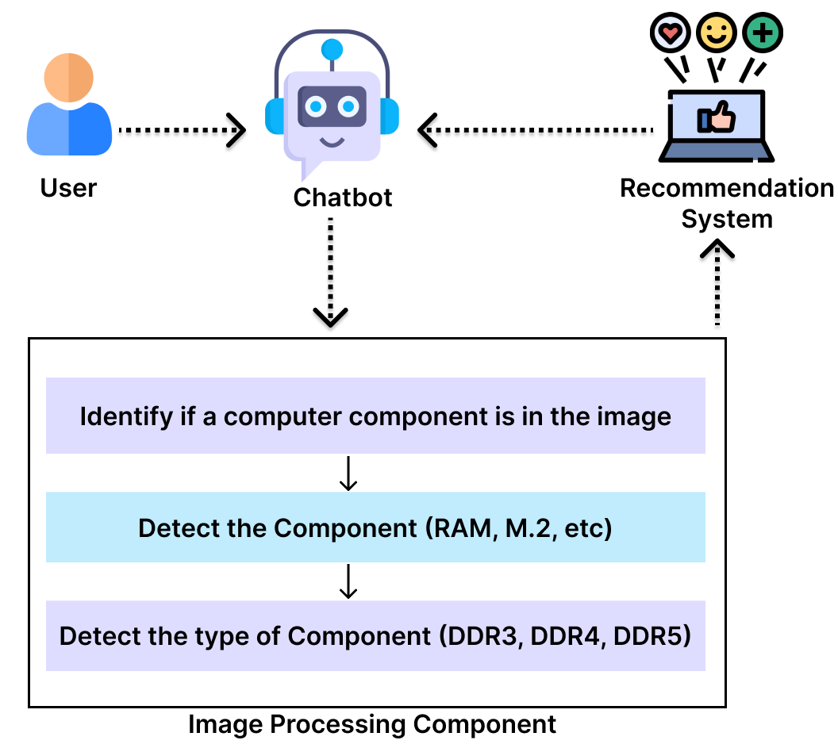
Methodology
IT20155520 | M.U. Amanullath | TMP-23-283

Slide 18
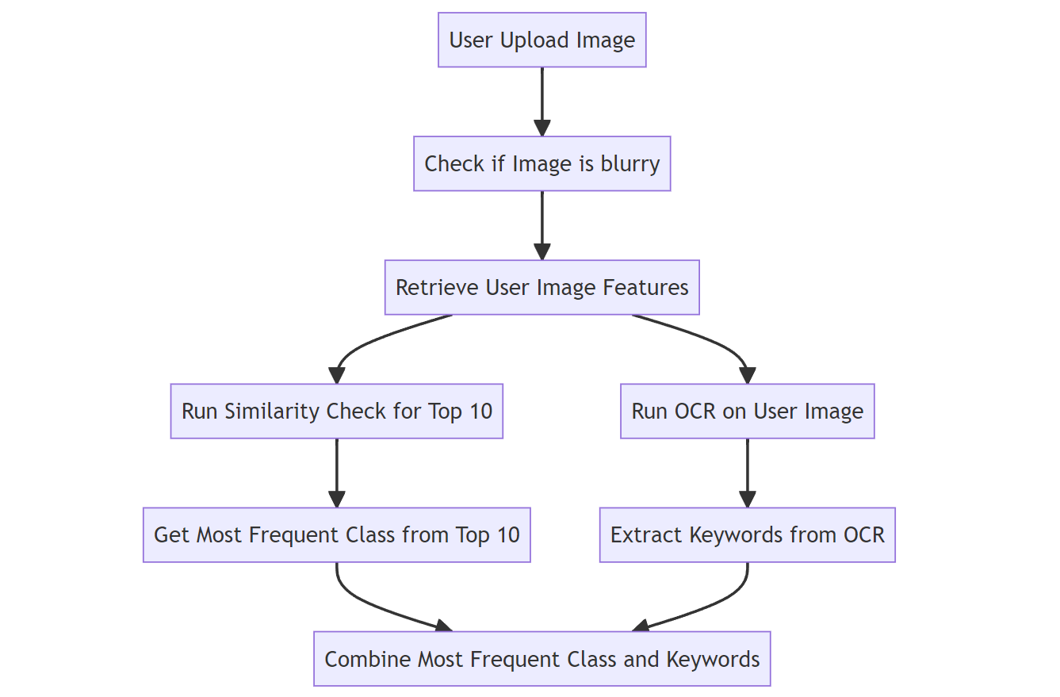
Methodology
IT20155520 | M.U. Amanullath | TMP-23-283

Slide 19
Results
For 255 images, 55 images per class
Custom CNN Model Accuracy - ~55%
Current Implementation Accuracy
Overall – 89.1%
Class wise -
GPU – 87.27
HDD – 94.55
CPU – 89.09
RAM – 81.81
SSD – 92.73
IT20155520 | M.U. Amanullath | TMP-23-283

Slide 20
Requirements
Functional requirements:
Ability to accurately identify computer hardware components.
Non-Functional Requirements:
Accuracy
Near-real time processing time
IT20155520 | M.U. Amanullath | TMP-23-283

Slide 21
REFERENCES
[1] A. Rosebrock, YOLO object detection with OpenCV, 12-Nov-2018. [Online]. Available: https://pyimagesearch.com/2018/11/12/yolo-object-detection-with-opencv/ [Accessed: Mar-2023].
[2] Girshick, R.; Donahue, J.; Darrell, T.; Malik, J. Rich feature hierarchies for accurate object detection and semantic segmentation, 2014. Available: https://www.cv-foundation.org/openaccess/content_cvpr_2014/papers/Girshick_Rich_Feature_Hierarchies_2014_CVPR_paper.pdf [Accessed: Mar-2023].
IT20155520 | M.U. Amanullath | TMP-23-283

Slide 22
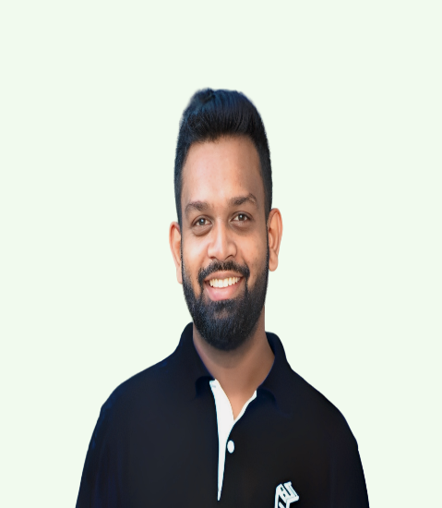
IT20237554 | Rathnaweera r.p.w.g
B.Sc. (Hons) Degree in Information Technology Specialized in Data Science
IT20237554 | Rathnaweera R.P.W.G| TMP-23-283

Slide 23
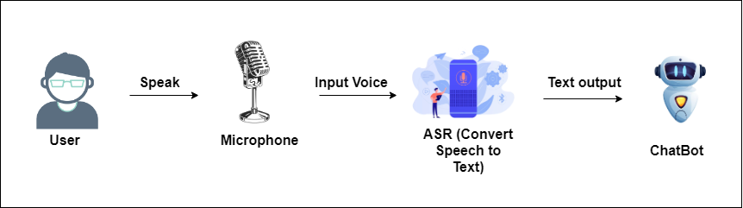
Specific and Sub Objectives
Main Objective
Development of an Automatic Speech Recognition system for feeding quires to Chatbot
IT20237554 | Rathnaweera R.P.W.G| TMP-23-283

Slide 24
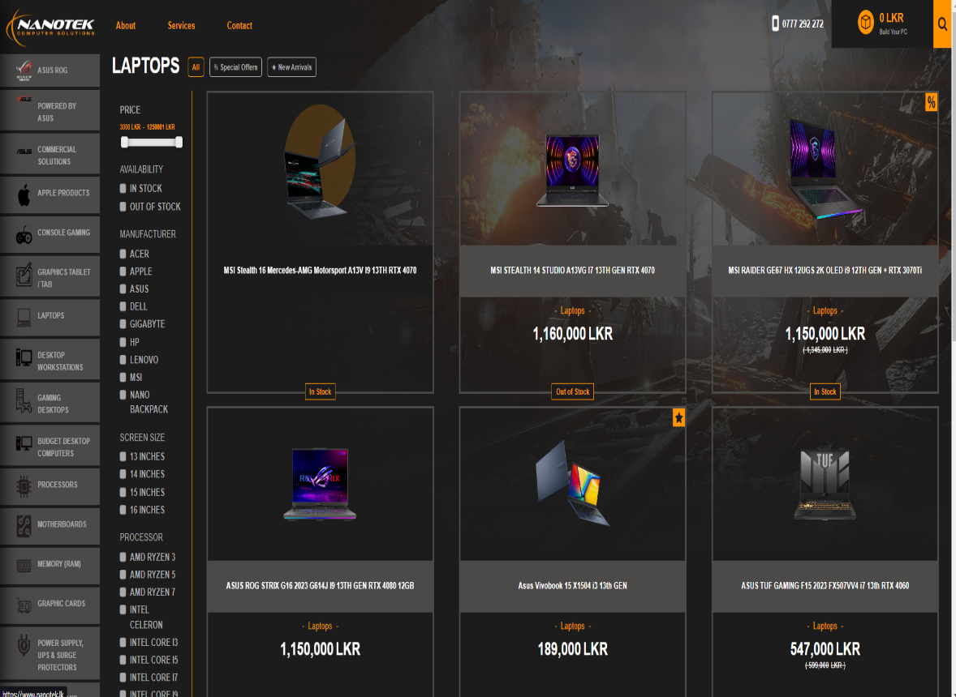
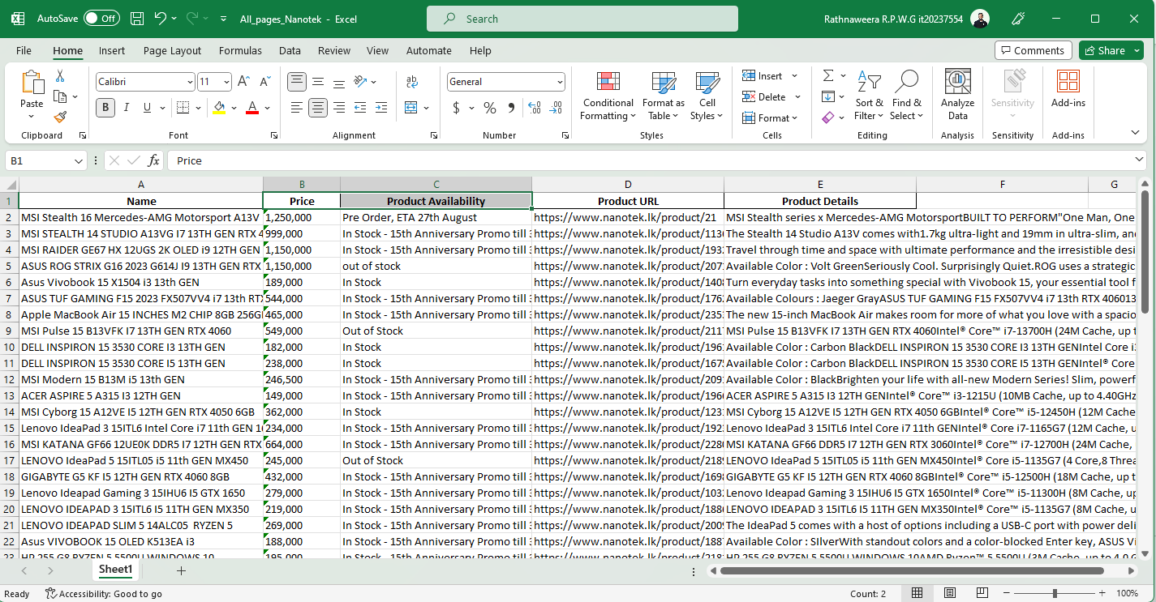
Specific and Sub Objectives
Sub Objective
Dataset creation
Developed custom data scrappers to gather data for the recommendation system
IT20237554 | Rathnaweera R.P.W.G| TMP-23-283

Slide 25
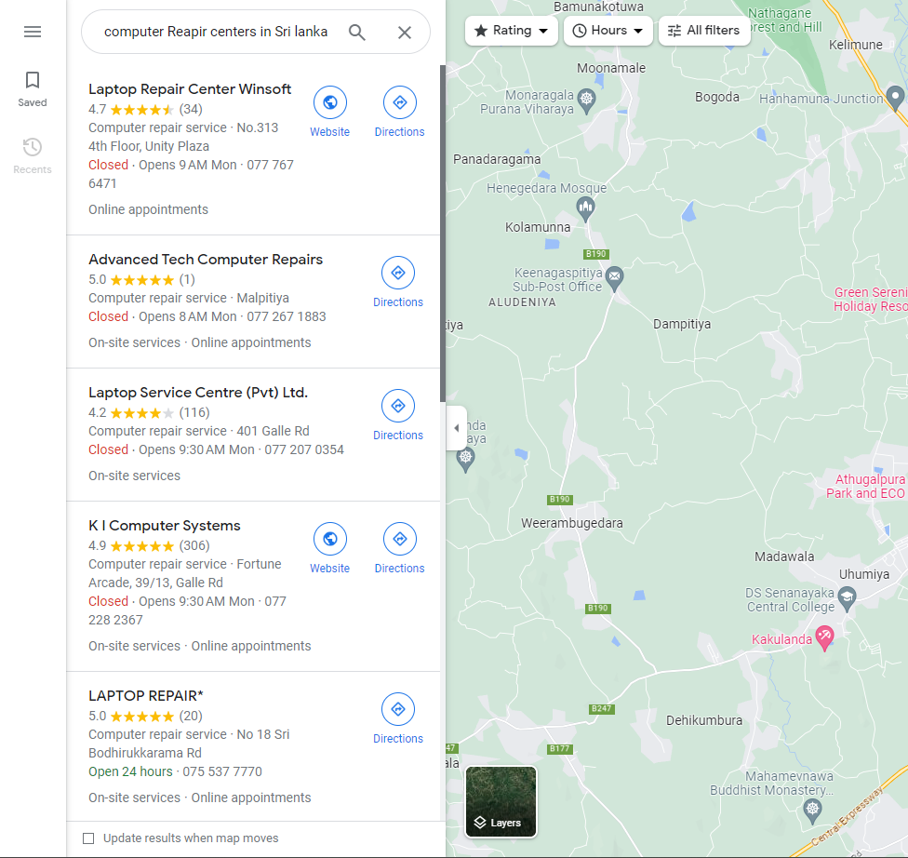
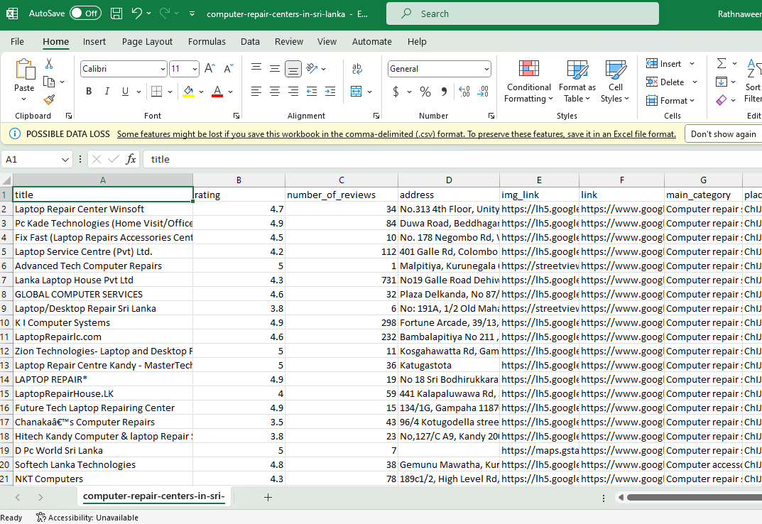
Specific and Sub Objectives
Google Maps Scraping
Developed a Google Maps Scrapper to scrape the computer repair centers for recommendation
IT20237554 | Rathnaweera R.P.W.G| TMP-23-283

Slide 26
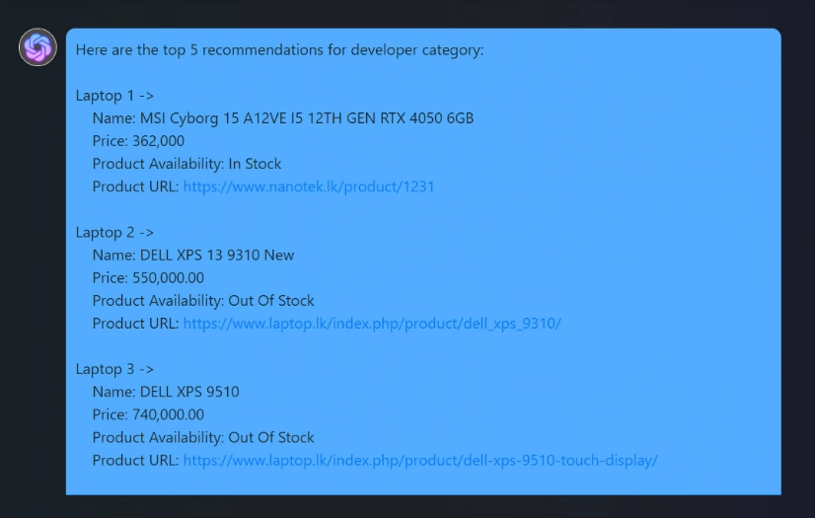
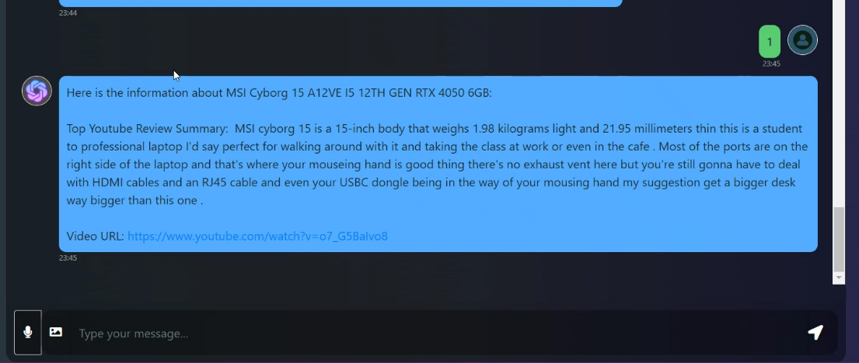
Specific and Sub Objectives
Reviews automation
Suggest the video link and a summary of a YouTube review regarding a recommended device to the user.
Chatbot Recommended laptops
When selecting 1st recommended device it will show a summary review of that device to the customer
IT20237554 | Rathnaweera R.P.W.G| TMP-23-283

Slide 27
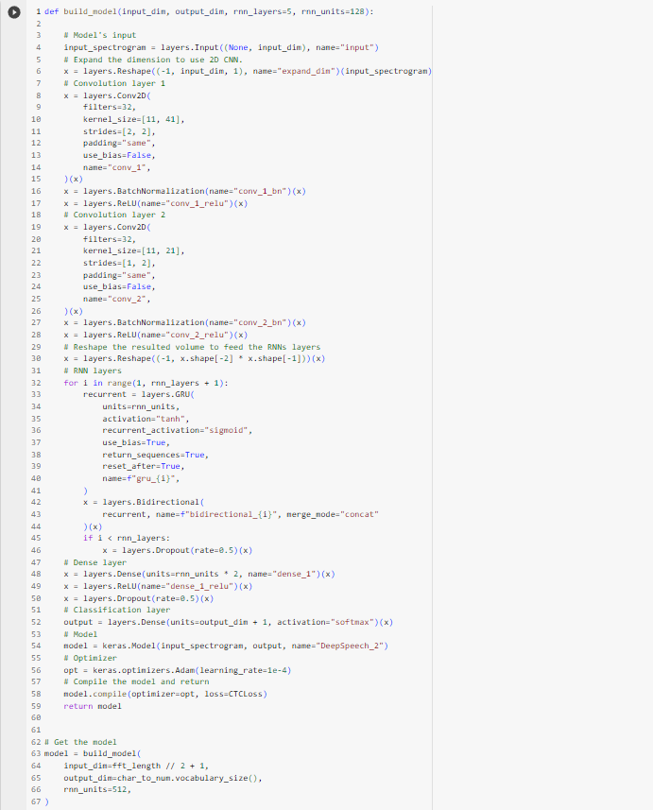
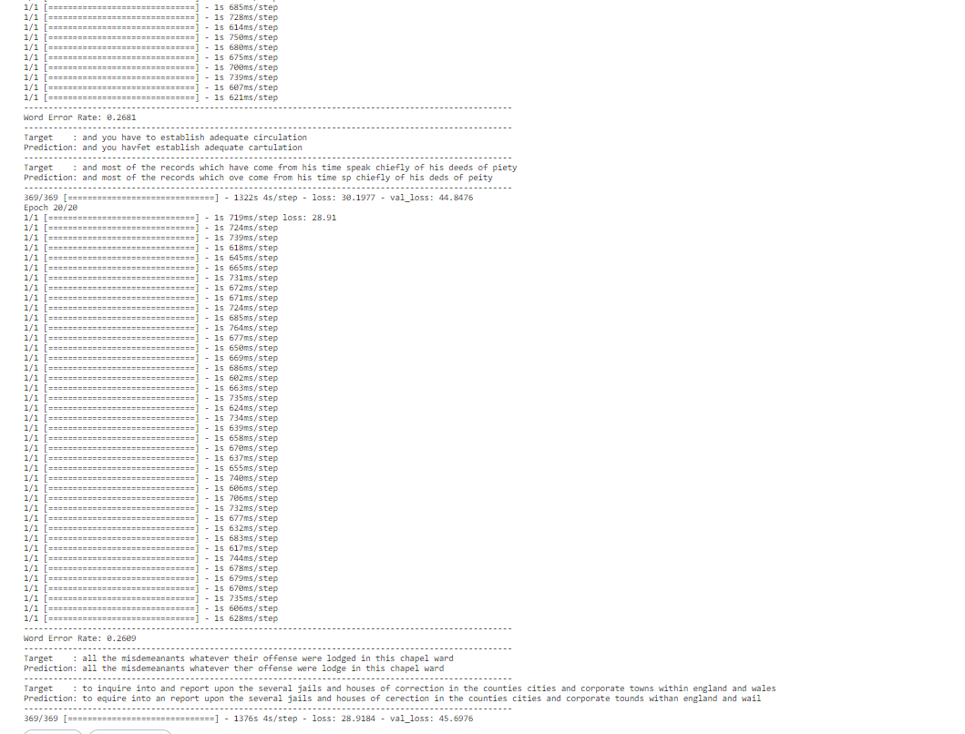
ASR – CTC Approach(Based on Deep Speech 2)
Connectionist temporal classification used where
It’s a model with RNN and CNN and trained on LJ speech dataset
Downsides of this model was it requires high computational power and less accurate even after running 20 epochs
IT20237554 | Rathnaweera R.P.W.G| TMP-23-283
Notes:
CTC –Connectionist Temporal Classification
Encoder only and a linear classification CTC on top of it as a head
Disadvantages – Spelling errors
Trains entirely on unlabeled data
Mostly popular ASR models like Wav2Vec2 ,HuBERT are based on CTC architecute

Slide 28
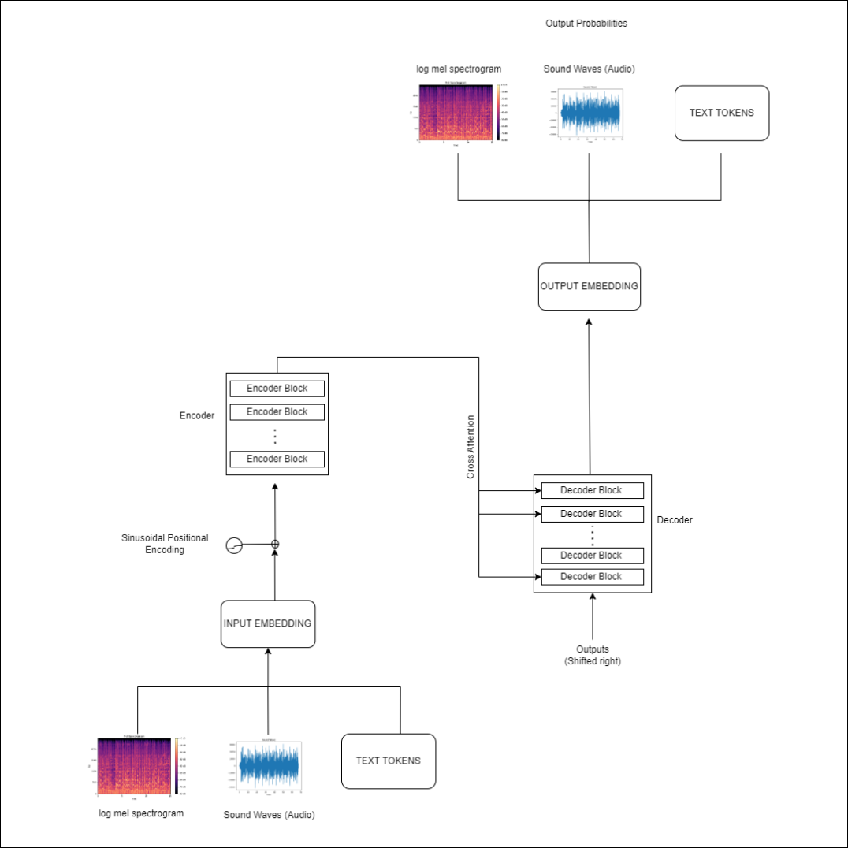
ASR – Seq2Seq Approach
Used Whisper model which was released in end of September 2022 where it has been trained for 680,000 hours of audio data and fined tuned this whisper model for my requirements with “Commen Accent” dataset.
IT20237554 | Rathnaweera R.P.W.G| TMP-23-283
Notes:
Sequence to Sequence model architecture which uses both encoder and decoder which is linked via cross attention mechanism.
Where Encoder computes hidden-state representations of audio inputs
And decoder plays the role as language model
Disadvantages – Slower Decoding –decoder steps happen one step at a time
More data hungry – requires significantly more training data to reach convergence
######################################
Dataset.
For this research purpose, we are going to target the Sri Lankan audience which means most of our English accent is a bit different when compared to the other countries' English accent, Sri Lanka India Bangladesh Pakistan are categorized into South Asian countries so that for in Sri Lankan basically we are using that speaking accent of English. So, we got a dataset named Common Accent which consists of South Asian voice clips.
Data preprocessing for the model.
Sampling rate – Measures the values of continuous signals of a fixed timestamp.
The number of samples taken in one second was measured in hertz.
Human speech is below 8000Hz so in this model, I had to resample the data into 16000Hz sampling rate is enough.
High sample rate – not capturing more information and high computational power.
A low sampling rate results in information loss which is why I got a mid-range of 16KHz.
We created spectrograms as model inputs where speech helps to identify the different vowel sounds as each vowel is characterized by frequencies.
The widely used spectrogram is Mel -the spectrogram for speech processing shows the frequency content of an audio signal over time but on a different frequency axis log-Mel-spectrogram.
Logmel spectrograms are used due to their capability of capturing more meaningful features of the audio signals from human perception.

Slide 29
Best Approach
CTC Approach | Seq2Seq Approach
High usage of computational power | Comparatively low usage of computational power
High rate of spelling errors | Low rate of Spelling errors
Only use Encoder | Use both decoder and encoder ( Can enhance the ASR for multiple languages)
Word Accuracy is Low | Word Accuracy is High
Difficult to handle High robustness, Noise inputs | High robustness, Noise inputs can be handled
Due to the above comparison I had selected the seq2seq architecture model to fit for the chatbot
IT20237554 | Rathnaweera R.P.W.G| TMP-23-283

Slide 30


Evaluation Metrices
$$WER=\frac{S+I+D}{N}$$
There are different word error categories as Substitution, Insertion Deletion in both word level and character level Here we used the Word level, which calculates the substitutions insertions, and deletions on a word level These errors are annotated on a word-by-word basis,
S=substitute
D=Delete
I=Insertion
N= Total number of words
Word Error Rate is an error matrix that can be convert into accuracy matrix
$$W_{Acc}=1−WER$$
IT20237554 | Rathnaweera R.P.W.G| TMP-23-283

Slide 31
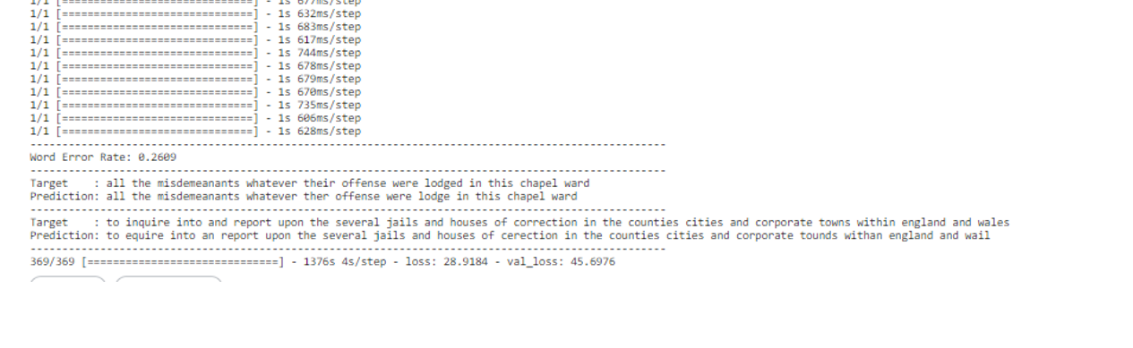
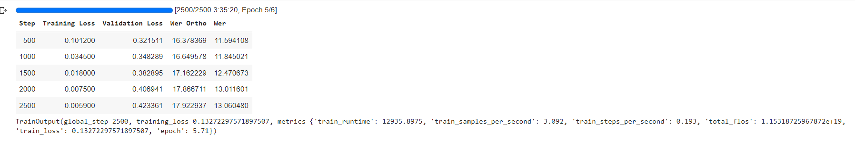
Model Results
CTC – Model based on Deep Speech2 | Seq2Seq Whisper finetuned model
WER = 0.26 (26%) W_{Acc} = 1- 0.26 = 0.74 (74 %) | WER = 0.13 (13%) W_{Acc} = 1 – 0.13 = 0.87 (87 %)
IT20237554 | Rathnaweera R.P.W.G| TMP-23-283

Slide 32
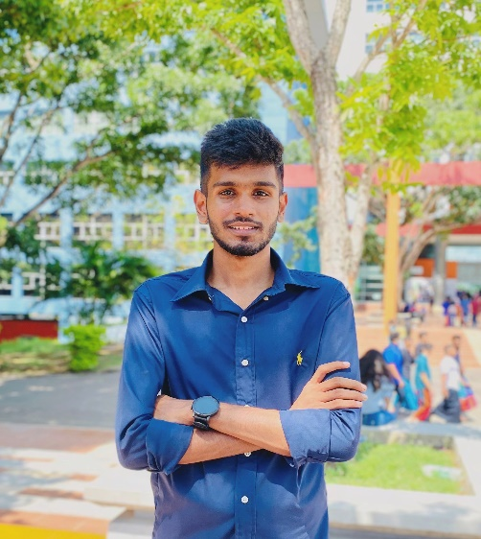
IT20125998 | h.a.m sENADHEERA
BSc (Hons) in Information Technology specialized in
Data Science
IT20125998 | Minindu Senadheera | TMP-23-283

Slide 33

Background
Usually when someone want to buy an electronic device especially smart devices a techy person would at least do some research on the device for a week, this include
finding a device matches to him
Watch reviews on the device in YouTube, social media and other websites
Compare the specifications and prices with other similar devices and dealers
For a person with low technical background this is a challenging process, first thing he would do is get advice from one of his friend. Goal of our chat bot is to be that friend!
IT20125998 | Minindu Senadheera | TMP-23-283

Slide 34
Research Gap
The majority of the suggested laptop recommendation systems prioritize user preferences and laptop features over external criteria like price, brand image, and available shops to buy.
Although user preferences and laptop functionalities can change over time, few studies take this into account when recommending laptops. To create recommendation systems that can vary as user preferences and laptop features do, more study is required.
Several of the studies lacked through analysis of real-world datasets regarding repair centers. To evaluate the performance and usability of these technologies in real-world contexts, additional study is required.
Research gap | Existing Systems | Proposed System
Doesn’t consider external factors like budget, availability |  | ✅
User preference, availability, prices, requirements change overtime |  | ✅
Model trained through real world datasets using actual repair centers |  | ✅
Use multiple algorithms and give the most accurate results set |  | ✅
IT20125998 | Minindu Senadheera | TMP-23-283

Slide 35

Research Problem
How could a person with low technical knowledge find a laptop or computer repair center suits for his needs without the need of giving his technical requirements?
How well the system understand the user's requirement with or without the presence of technical data?
IT20125998 | Minindu Senadheera | TMP-23-283

Slide 36
Specific Objective & Sub objectives
Specific Objective
Main objective of this recommendation system is to recommend laptops to users as per their requirements with all the information they need at one place.
Recommend repair Centres in proximity with including google reviews.
Classification of users based on their query and computers based on their specs.
Sub Objectives
Preprocess the dataset
Build a content-based recommendation model
Build a collaboration-based recommendation model
Inject parameters / features obtained from NLP & ASR models to recommendation model.
Provide the optimum results from both algorithms based on the user query
IT20125998 | Minindu Senadheera | TMP-23-283

Slide 37
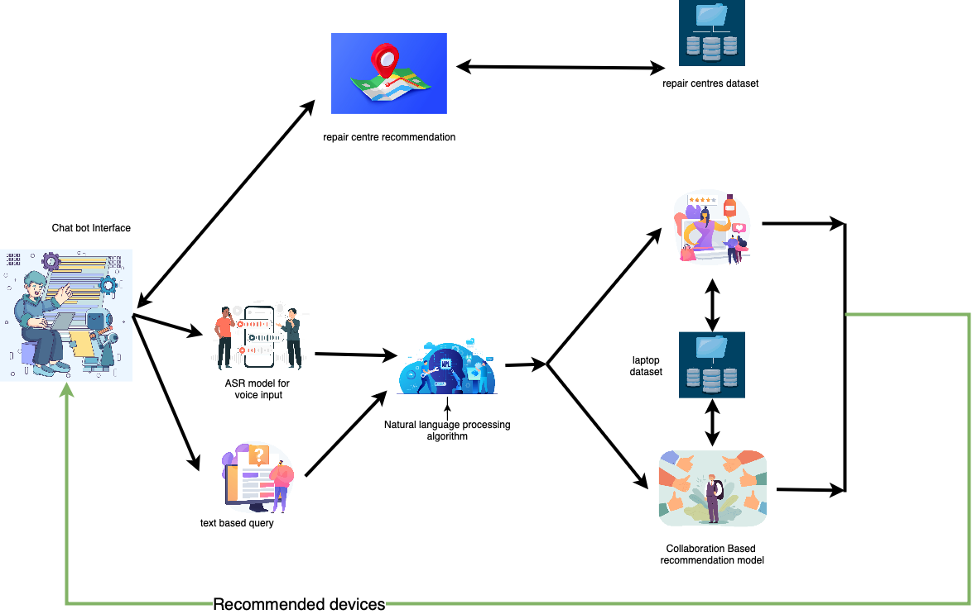
Component diagram
IT20125998 | Minindu Senadheera | TMP-23-283

Slide 38

Thank You!

